Slide 1
Chapter Board of Directors Orientation
Notes:
Welcome to chapter board orientation! Well be discussing all things chapter related today to ensure you understand your role as a chapter leader.

Slide 2
Current State of the Chapter
Membership by Type
Member Type | Not Certified | Certified | Total
Allied Professional
Pre-Professional
Professional
Retired Professional
TOTAL
Notes:
Pull this information from the chapter portal under Reports ‘Members by Count’.
As you can see YOUR STATE currently has # members of which # are certified. With such a large membership, I’m hopeful the YOUR STATE chapter will have no trouble growing the level of participation and number of volunteers.

Slide 3
Overview of the Board
  Governance
  Leadership
  Stewardship
Notes:
As a board participant, your role is to govern, lead and provide stewardship for the chapter

Slide 4
Governance
Governance - setting policy and making decisions.
The board governs on behalf of people who are not seated at the table
Think of “trustee”… what are you entrusted to do?
Defining and achieving results
Set policy
Make decisions
Work as a team to gather info; communicate w/ stakeholders Interactions w/ stakeholders; represent the organization to the public
Notes:
Governance is to set polices and make decisions:
You are making decision on behalf of people who have entrusted you to do so
Defining results and work to achieving results
Set policies and monitor the implementation of these policies
Work as a team to gather info; communicate and interact w/ members
You represent the organization to the public
And there are several best practices that constitute good governance
Governance is to set polices and make decisions:
You are making decision on behalf of people who have entrusted you to do so
Defining results and work to achieving results
Set policies and monitor the implementation of these policies
Work as a team to gather info; communicate and interact w/ members
You represent the organization to the public
And there are several best practices that constitute good governance:
Good governance is accountable
As leaders, you will have an obligation to report, explain and be accountable for the consequences of decisions you have made on behalf of members
Good governance is transparent
Members should be able to clearly see how and why a decision was made – what information, advice and consultation the board considered, and which procedural requirements (when relevant) the board followed.
Good governance follows the bylaws and policies and procedures
This means that decisions are consistent with relevant legislation or bylaws and policies & procedures
Good governance is responsive
The board should always try to serve the needs of the members while balancing competing interests in a timely, appropriate and responsive manner.
Good governance is equitable and inclusive
A board’s wellbeing results from all of its members feeling their interests have been considered by the board in the decision-making process. This means that all groups, should have opportunities to participate and be heard.
Good governance is effective and efficient
The board should implement decisions and follow processes that make the best use of the available people, resources and time to ensure the best possible results for their members.
Good governance is participatory
Anyone affected by or interested in a decision should have the opportunity to participate in the process for making that decision..
These are just a few best practices to following when we are practicing governance.
Any questions?

Slide 5

Leadership
Leadership - serving as a ‘think tank’ for the organization and defining opportunities.
Board role is strategic leadership
The board continuously acts as a “think tank” for what the organization can achieve
Observe the industry
Help develop strategic alliances; define opportunities
Notes:
Consider thinking of leadership as a ‘think tank’. Leadership gives us the chance to define opportunities and think strategically about long term goals for the chapter
Through leadership
We have the opportunity to establish a clear vision and share that vision with others so that they will follow willingly
As leaders we provide the information, knowledge and methods to realize that vision
Setting an example and at the same mentoring incoming officers or other volunteers to follow in our footsteps
As leaders, we need to observe the industry in its current state, as well as where it is headed, as this allows us to plan ahead for our member’s needs
Are there any questions in regards to board leadership and the expectations?

Slide 6
Stewardship
Stewardship - ensuring accountability for use of resources and approving the budget.
Commitment to the mission
How should the organization use its resources (time, budget money, etc.)?
How do we ensure accountability?
How do we stay informed and up-to-speed (e.g., review of reports, metrics)? Ensure the organization is carrying out its mission.
Evaluate/assess effectiveness
Notes:
In addition to leadership, the board is responsible for stewardship of the chapter’s resources
Stewardship is ensuring accountability for use of resources and approving the budget.
So we need to ask ourselves a few questions to ensure the proper care and handling of resources
How should the organization use its resources (time, budget money, etc.)?
How do we stay informed and up-to-speed (e.g., review of reports, metrics)?
How do we ensure the organization is carrying out its mission?
How do we evaluate/assess effectiveness?
Basically, through stewardship we are ensuring the resources are being used responsibly and for the right purposes.
Let’s pause here to see if anyone has questions?

Slide 7
Role of the President
Have a working knowledge of officer and committee roles and be willing to help other volunteers understand their duties
Create agenda for board and business meetings
Chair board and business meetings and do so using ‘Robert’s Rules of Order’
Oversee committee activities
Train president-elect to competently take over after your tenure
Communicate with membership on a regular basis (e.g. via the newsletter)
Submit required chapter forms to ANFP Chapter Relations (see chapter minimum standards)
Delegate required chapter forms (or appropriate sections) to board members
Understand and communicate expectations of affiliate agreement to board members
Lead chapter
Establish annual goals
Notes:
The president wears many hats. However, the main role of the president is to lead. Members will look to you to take action, be accountable and have answers.
The president should have a working knowledge of officer and committee roles, and be willing to help other volunteers understand their duties, and work with other board members to establish annual goals.
They should provide timely and regular communication with chapter members, and update them as needed with urgent chapter matters.
Also, as the president fulfills their duties throughout the year, they should also be mentoring and training the president-elect to competently take over after their term has ended. This ensures a seamless transition and continuation of ongoing projects and initiatives.
Other administrative duties include:
Create agenda for board and business meetings
The will run the board and business meetings and do so using ‘Robert’s Rules of Order’
Oversee committee activities
Submit required chapter forms to ANFP Chapter Relations for rebate purposes
Delegate required chapter forms (or appropriate sections) to board members
Understand and communicate expectations of affiliate agreement to board members
Now, I mentioned a couple things here, Robert’s Rules of Order, rebates, chapter forms, that some you may be familiar with. If not, there is a ‘cheat sheet’ available on ANFPConnect under Board Governance.
Let’s pause here. Are there any questions or concerns regarding the role responsibilities or expectations?

Slide 8
Role of President-Elect
Learn president’s responsibilities
Assume duties of president in her/his absence or disability
Oversee activities of district officers, program committee, and tellers committee
Make every effort to audit national board of directors meeting at ANFP’s Annual Conference in order to learn as much as possible about organizational goals, objectives, policies, and procedures.
Attend all chapter board and business meetings
Serve as a member of chapter’s finance committee
Appoint committee chairs and members the spring before your year as president
Write tasks of each committee and explain these to volunteers. These can include goals, budget, objectives, etc.
Actively recruit volunteers during your term. Succession planning is essential to continue an active chapter.
Create a plan to implement plans immediately upon installation.
Notes:
As mentioned, the president-elect will need to learn the president’s responsibilities and be prepared to take over their role in case of their absence or when their term is up.
As the president-elect trains under the president, they also need to create their own plan, to implement chapter plans immediately upon installation. Also, the president-elect plays a large part in the succession planning and is responsible for appointing committee chairs and members the spring before their year as president.
Other responsibilities include:
Actively recruit volunteers during your term.
Oversee activities of district officers, program committee, and tellers committee
Make every effort to audit national board of directors meeting at ANFP’s Annual Conference in order to learn as much as possible about organizational goals, objectives, policies, and procedures.
Serve as a member of chapter’s finance committee
Write tasks of each committee and explain these to volunteers. These can include goals, budget, objectives, etc.

Slide 9
Role of the Secretary
Notify invitees of board/business meetings at least 10 days in advance
Take, prepare and distribute meeting minutes.
Update chapter policies and procedures when needed. Forward document to ANFP Chapter Relations.
Oversee activities of newsletter editor and membership committee
Assist president-elect in staying updated on district activities (if applicable)
Invite students to state and district meetings and explain the benefits of ANFP membership and being a CDM
Oversee ballot preparations and voting procedures
Collaborate with membership committee to contact new, dropped, and potential members
Notes:
Next, is the role of the secretary. The secretary is responsible for many of the business aspects of the board. They are responsible for notifying members of upcoming board and business meetings, and recording the minutes for these meetings. They assist the president-elect in staying updated on district activities (if applicable). The secretary ensures the chapter’s policies and procedures are kept up to date and national is made aware of any updates:
When it comes to officer election time, the secretary also oversees the ballot or slate preparations and voting procedures (if applicable.)
Other duties include:
Oversee activities of newsletter editor and membership committee
Invite students to state and district meetings and explain the benefits of ANFP membership and being a CDM
Collaborate with membership committee to contact new, dropped, and potential members
Any questions before we move on?

Slide 10
Role of the Treasurer
Prepare annual budget
Maintain financial records
Complete IRS Form 990 annually (for tax exemption)
Responsible for reimbursement, paying bills, financial reports, etc.
Report financial condition of chapter to board and membership
Develop use for excess funds to benefit ANFP members
Understand state’s policies and procedures for: bonding, signing checks with more than one signature, authorizing bills prior to payment, reimbursing officers and committee members, handling accounts for chapter meetings, depositing excess funds into interest-bearing accounts
Have all accounts audited before passing books to incoming treasurer
Notes:
Last, but certainly not least is the role of the treasurer. The treasurer is responsible for the chapter’s financial matters, including maintaining the financial records for the chapter, Maintaining the checking and savings accounts, and reporting the financial condition of the chapter to the board and the membership
Additionally the treasurer will be asked to prepare the annual budget with input from other board members. They also should understand state’s policies and procedures related to bonding, signing checks with more than one signature, authorizing bills prior to payment, reimbursing officers and committee members, handling accounts for chapter meetings, depositing excess funds into interest-bearing accounts.
Since the role of the treasurer is so involved, the board may want to think about creating the role of the treasurer-elect, similar to the ANFP national board. This allows the incoming treasurer to be fully trained and knowledgeable about the role before taking office.
Additional duties include:
Complete IRS 990 Form annually (for tax exemption and rebate purposes)
Responsible for reimbursement, paying bills, financial reports, etc.
Develop use for excess funds to benefit ANFP members
Have all accounts audited before passing books to incoming treasurer
Are there any additional questions at this time?

Slide 11
Affiliate Agreement
Agreement between all chapters and ANFP National
ANFP shall:
  Grant to Chapter and the exclusive right to be affiliated with ANFP
  Host and edit the approved chapter website;
  Pay dues rebates to the Chapter in accordance
  Dedicate ANFP staff to maintain and enhance the ANFP Chapter relationship
Notes:
Ok, now let’s move into more chapter specific topics starting with the affiliate agreement which is an Agreement between all chapters and ANFP National that basically demonstrates the mutual partnership between the two.
When you have some free time, be sure to take some time to read through it before the start of the volunteer year. And certainly feel free to reach out to ANFP staff or other board members if you have any questions or concerns.
There are several terms listed within the agreement, but here are a few highlights including:
exclusive right to chapter is granted to be affiliated with ANFP
ANFP Host and edit the approved chapter website;
Pay dues rebates to the Chapter (Bi-annually_
Dedicate ANFP staff to maintain and enhance the ANFP Chapter relationship

Slide 12
Affiliate Agreement
The chapter shall:
  Meet and maintain current Chapter Minimum Standards
  Comply with ANFP and Chapter bylaws
  Promote membership in ANFP and encourage the use of ANFP programs
  Establish and practice sound fiscal policies and be self-sufficient
Notes:
In turn, the chapter then agrees to the following:
Meet and maintain current Chapter Minimum Standards which we will review in a bit
Comply with ANFP and Chapter bylaws
Promote membership in ANFP and encourage the use of ANFP programs
Establish and practice sound fiscal policies and be self-sufficient,

Slide 13
Affiliate Agreement
Chapter shall complete the required IRS tax filings (Forms 990N, 990EZ, or 990 as appropriate)
Follow national’s fiscal year (June 1 – May 31)
Serve as host state for ANFP meetings
The Chapter is not liable or responsible for the debts or obligations of ANFP, and ANFP is not liable or responsible for the debts or obligations of the Chapter.
Notes:
Also the Chapter shall complete the required IRS tax filings (Forms 990N, 990EZ, or 990 as appropriate) this is typically completed in July
Follow national’s fiscal year (June 1 – May 31)
The Chapter is not liable or responsible for the debts or obligations of ANFP, and ANFP is not liable or responsible for the debts or obligations of the Chapter.
Again, please read through the affiliate agreement and familiarize yourself with the terms. Please let us know if you have any questions.
I want to pause here to see if anyone has any questions about anything we’ve covered this far?

Slide 14
Policies & Procedures
Policies and procedures define, regulate and inform the board how to run the chapter and ensure the chapter and their programs are managed effectively and efficiently.
Notes:
Next, polices and procedures. The policies and procedures template was also included in the email I sent yesterday.
Policies and procedures define, regulate and inform the board how to run the chapter and ensure the chapter and their programs are managed effectively and efficiently.
You can think of policies as the guide or ‘what the chapter should be doing’. Something like the chapter’s educational meeting or officer roles responsibilities. Whereas the procedure is ‘how you would handle it’ or the operations of a chapter. So the chapter’s meeting would only be held in the fall in a central location. Or qualifications to serve as an officer.
We ask that each chapter develop their own procedures and policies. You can do so my using the template we provide on ANFP Connect. Some chapters have chosen to use their own format and that’s fine too.
Some of the items that should be included in the policies and procedures are membership terms, accounts payable, meetings and elected officers.
Again, please review the template and let us know if you have any questions. We’re happy to help you through the process.
Does anyone have any questions so far?
I know for some of you that are new, this may be seem overwhelming at first, but don’t think you have to follow each policy or term to a ‘T’. And please remember we are here to help and assist. We want you each to feel confident in your role and have the knowledge to succeed.

Slide 15
Bylaws
Bylaws are considered a legal document that dictates how the organization must be governed
Chapter bylaws have been adapted from the ANFP national bylaws
Reviewed annually
Understand what each and every provision means.
Notes:
If there are provisions you do not understand, ask another board member or ANFP Staff
Bylaws are considered a legal document that dictates how the organization must be governed. They are in place to keep the chapter running efficiently and staying organized. They ensure member inclusion and fair opportunities for all chapter members. With ANFP chapter bylaws, they have been adapted from the ANFP national bylaws so they are very similar. Chapters are asked to review and submit their bylaws each year. A template is also available on ANFP Connect.
Bylaws should include terms on
Finances
Membership
Board of Directors
Elections
Meetings
Committees
You’ll notice the bylaws are very similar to the policies and procedures and in some cases have very similar language. However, bylaws tend be a little broader and do not include the ‘how to’ of what is stated. Additionally, change or revisions to bylaws need to be approved by the entire membership, whereas revisions to policies and procedures can be approved by the board only.
Again, I would take some time to be sure you understand each provision. Bylaws along with policies and procedures should also be reviewed annually.

Slide 16
Chapter Minimum Standards
Complete each submission (2 parts) of the Bi-annual Chapter Achievement Rebate report (formerly known as State Achievement Award) throughout the volunteer year, with final submission in by January 15
Complete 990 IRS filing annually (for tax exemption)
Hold a fall Chapter educational meeting, utilizing the ANFP Approved Speaker List/Directory Program Resource Guide. (This is a speaker directory from the Professional Development Committee identifying topics and speaker suggestions.) Dates and contact information for the meeting must be submitted through the chapter portal
One chapter leader per each chapter to attend one (1) chapter leadership training session of their choice each fiscal year including chapter leadership training sessions at the Regional Meetings, Annual Conference & Expo (ACE) or approved Online Chapter Leadership Course via the Marketplace
Hold board of director’s election each year, or as directed by Chapter bylaws, by mail or electronic ballot ensuring that each member has one vote or applying the slate process; and
Establish a Finance Committee consisting of, at a minimum, two board members and two non-board members
Submit one nomination for any of the ACE awards each fiscal year.
Submit an outline of a succession plan annually
Notes:
Ok, let’s move on to chapter minimum standards. In order for chapters to be considered active and to be eligible, a chapter must meet a set of standards. The standards are listed in the Volunteer Handbook, which is also available on ANFP Connect under Volunteer 101. The handbook is a great tool for volunteers. I would ask each of you to download the handbook to review all the standards.
So some of the chapter standards include:
Complete Bi-annual Chapter Achievement Rebate Report form (2 parts)
Submit volunteer names upcoming volunteer year
Hold a fall Chapter educational meeting
Maintain communication with members
Send all Chapter member correspondence to ANFP Headquarters;
Submit annual update of Chapter bylaws and policy and procedures
Encourage attendance by at least one Chapter leader at the Annual Conference
Hold board of directors election each year, or as directed by Chapter bylaws
Hold regularly scheduled board of directors meetings
Again, the full list of standards is included in the volunteer handbook, which you’ll want to keep handy during your term.
Once the chapter has met all the standards as well as the requirements for the rebate, they are eligible to receive a bi-annual rebate. In addition to the minimum standards chapters must also File for 990 e-receipt and submit a Signed affiliate agreement. Once they have met the requirements which have specific deadlines throughout the year, the rebate (distributed in two separate payments) will be directly deposited to the assigned bank account.
Rebates are to help off et costs of running the chapter and provide support to your members. Amounts are based on the number of members. So it benefits chapters to continually grow their membership. The first half can be distributed as early as July and the second half is typically distributed January. Also, prior to the distribution of the first half, ANFP allots $135 from each chapter for bonding insurance for each chapter regardless of size.

Slide 17
Rebates
Number of members | New Amount * (Annually)
0 - 74 | $1,100
75-149 | $1,500
150 - 225 | $2,000
226 - 299 | $2,200
300 - 399 | $2,800
400-499 | $3,000
500-799 | $3,500
800-1091 | $4,600
Notes:
Here is the breakdown of dollar amount based on membership. Please note the amount you see here, does not reflect the $135 fee for liability and bonding insurance for chapter leaders.
Though you will receive reminders throughout the year from National for each of these rebate requirement deadlines, you may want to begin to look ahead and determine who will be responsible for what. For instance, we suggest the President review and sign the affiliate agreement and the treasurer file the 990 form. As a board, you will all need to review the policies and procedures as well as bylaws, but you will need to determine who will handle the administrative side of things, like who will keep copies and who will submit these documents to national.
There is a chapter minimum standards and rebate requirements checklist, that is available on ANFPConnect. We will review this and we will can roles accordingly.
Additionally, if we wish to apply for any of the chapter awards, we may wish to incorporate these requirements into our checklist and assign them as well.
So I’m going to stop here to see if anyone has any questions about rebates?

Slide 18
Strategic Plan - What Are We Working Towards?
The strategic plan is your roadmap: it tells you where you want to go, how to get there, and what a successful journey will look like.
Vision
The Certified Dietary Manager is the cornerstone of the collaborative Dietetics profession.
Mission
Position the Certified Dietary Manager as the expert in foodservice management and food safety
Notes:
When we begin to develop your own strategic plans, we would like to see chapter strategic plans tie into the national plan as it serves all our members and the mission.
In the meantime as you start to think of chapter goals, think of the strategic plan as roadmap; it tells you where you want to go, how to get there, and what a successful journey will look like. You’ll also want to keep in mind ANFP’s vision and mission when you start the process.

Slide 19
ANFP Strategic Plan
Goal 1: The CDM, CFPP is recognized as the most vital staffing qualification in non-commercial foodservice management.
Goal 2: CDM, CFPPs value and maintain continued professional competency.
Goal 3: Food system operations are more efficient in the areas of food management and food safety when employing a CDM, CFPP.
Notes:
Here is the current strategic plan.
Goal 1: The CDM, CFPP is recognized as the most vital staffing qualification in non-commercial foodservice management.
Goal 2: CDM, CFPPs value and maintain continued professional competency.
Goal 3: Food system operations are more efficient in the areas of food management and food safety when employing a CDM, CFPP.
Again, please be on the look out for more information regarding the strategic plan in the coming months.
Are there any questions at this time?

Slide 20
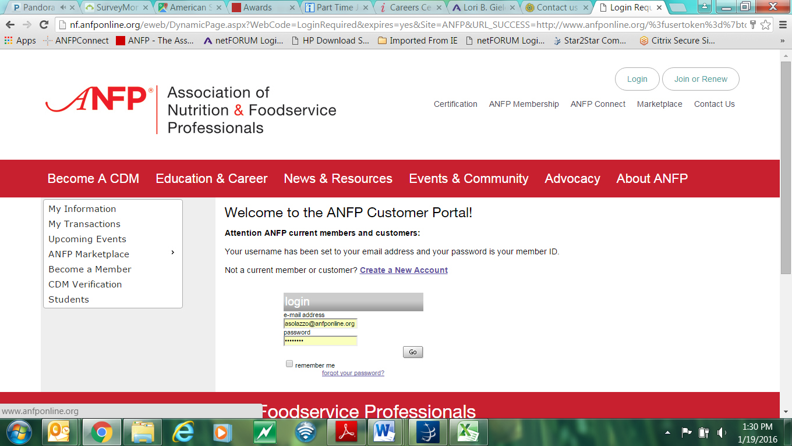
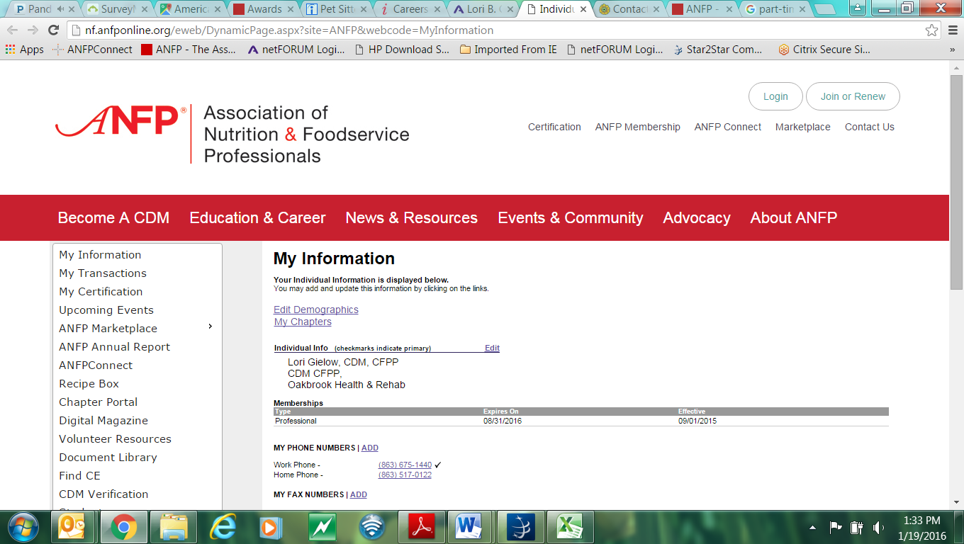
Chapter Portal
Notes:
As volunteer leaders, you will have access to the chapter portal starting June 1, when your term officially begins.
The chapter portal is a platform that allows you to post reports, update officer information, pull rosters and submit website edits. Once you have been granted access to the portal, we encourage each of you to become familiar with the functions that are available in it.
So we’re going to give you a brief tutorial using screen shots.
Ok, you will first need to login to ANFP member portal. Once you’ve logged in, you’ll want to go to the left-hand side of your screen and select ‘chapter portal’.

Slide 21
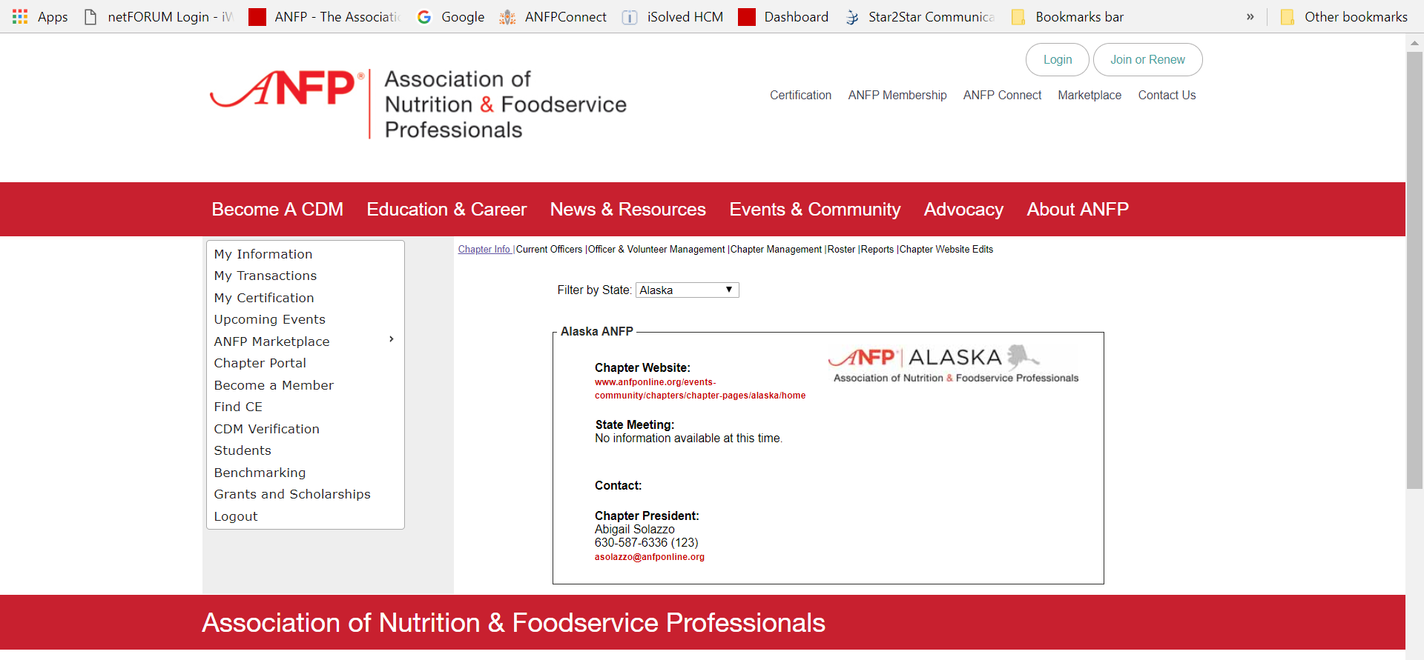
Chapter Portal
Notes:
From here you’ll see the chapter info page which is an overview of the chapter events and the chapter president. You’ll also see here you can filter by state. You can also access the state websites when you filter by state as well.

Slide 22
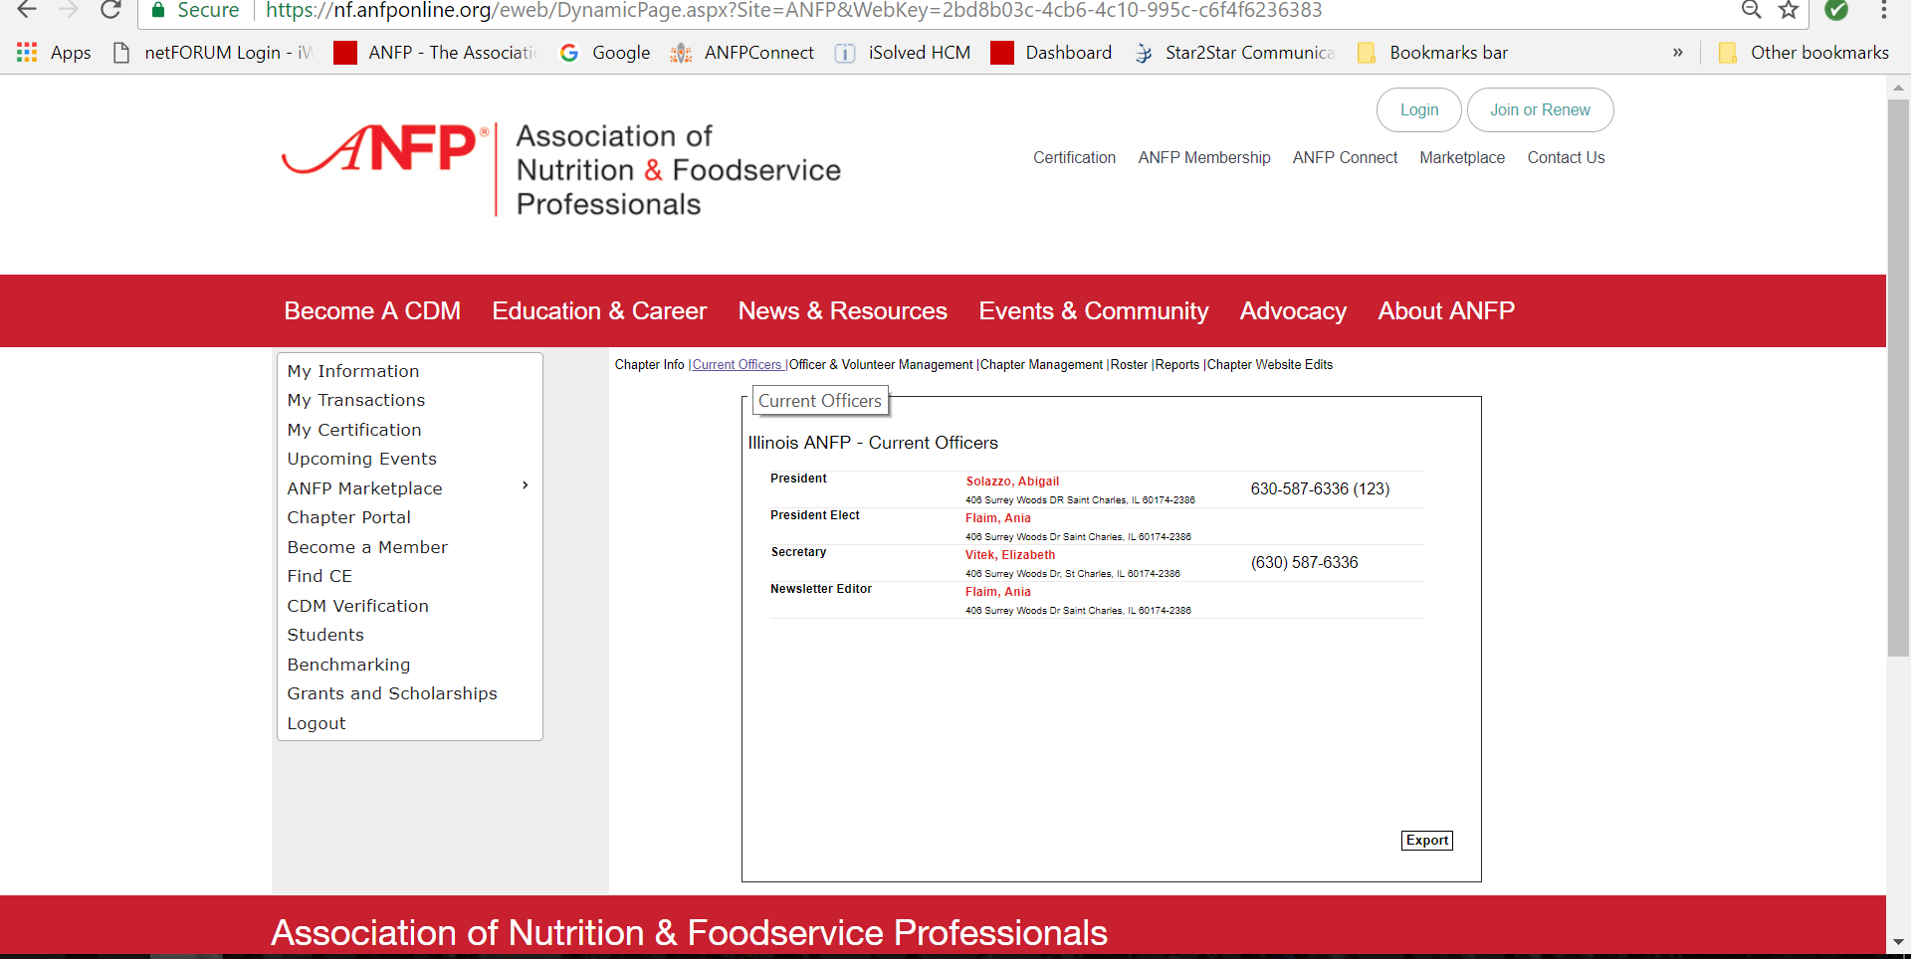
Chapter Portal
Notes:
Next, current officers. This where you can find a list of all your state chapters current officers contact information. You can also export this list directly from this page by hitting the ‘Export’ button. And as you see this exports as an Excel document.

Slide 23
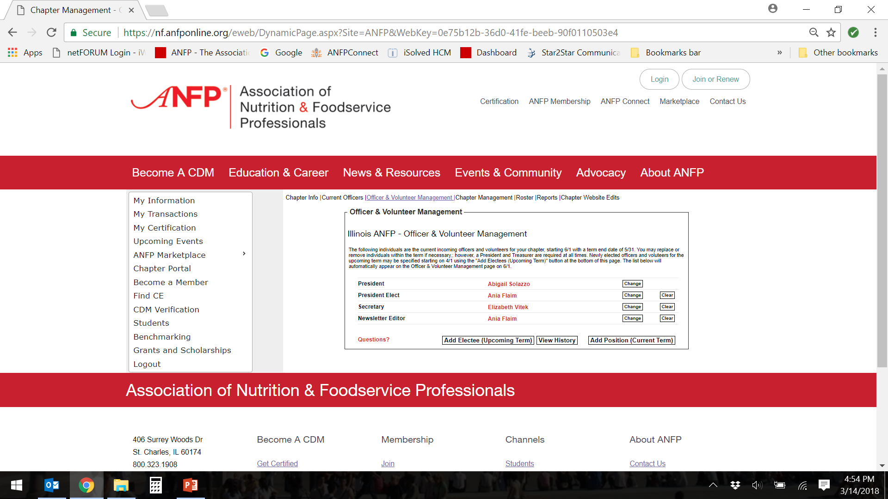
Chapter Portal
Notes:
Then onto Officer & Volunteer Management. This is where you will go to update, add or change your officers prior to the volunteer year or as necessary. As you can see here, the following individuals are the current officers or volunteers. While you can change or remove these names throughout the year if someone should step down, a President and Treasurer are required to be in the record at all times.
As of April 1 of each year, you can begin to enter in incoming officers, but they will not appear on the chapter website until 6/1 as the volunteer year is from 6/1 to 5/31 same as the fiscal year.
When you go to add the new officers, please be sure you clear the member’s name currently holding the position. This will help to avoid overlap listing of two members in the same position.
Additionally, if you wanted to add an officer, as you likely will once you determine your other volunteer roles, you can do so by clicking here, and enter the information in one of the fields.
The results for the member will appear here, you will then hit select and pick an option from the drop down menu and hit select.
Any questions here?

Slide 24
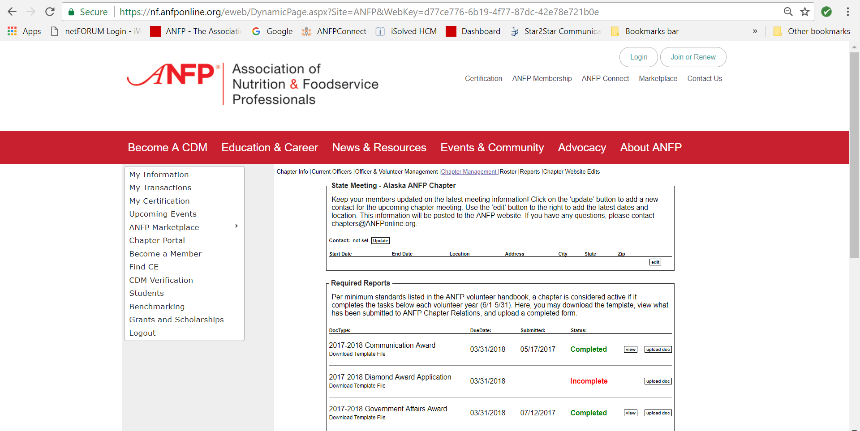
Chapter Portal
Notes:
Next is the Chapter Management tab, under this tab, you can update or add your chapter meeting information or chapter contact person information as well.
Also, this is where you can download award applications and forms, bylaw and affiliate agreement templates and upload the 990 e-receipt.

Slide 25
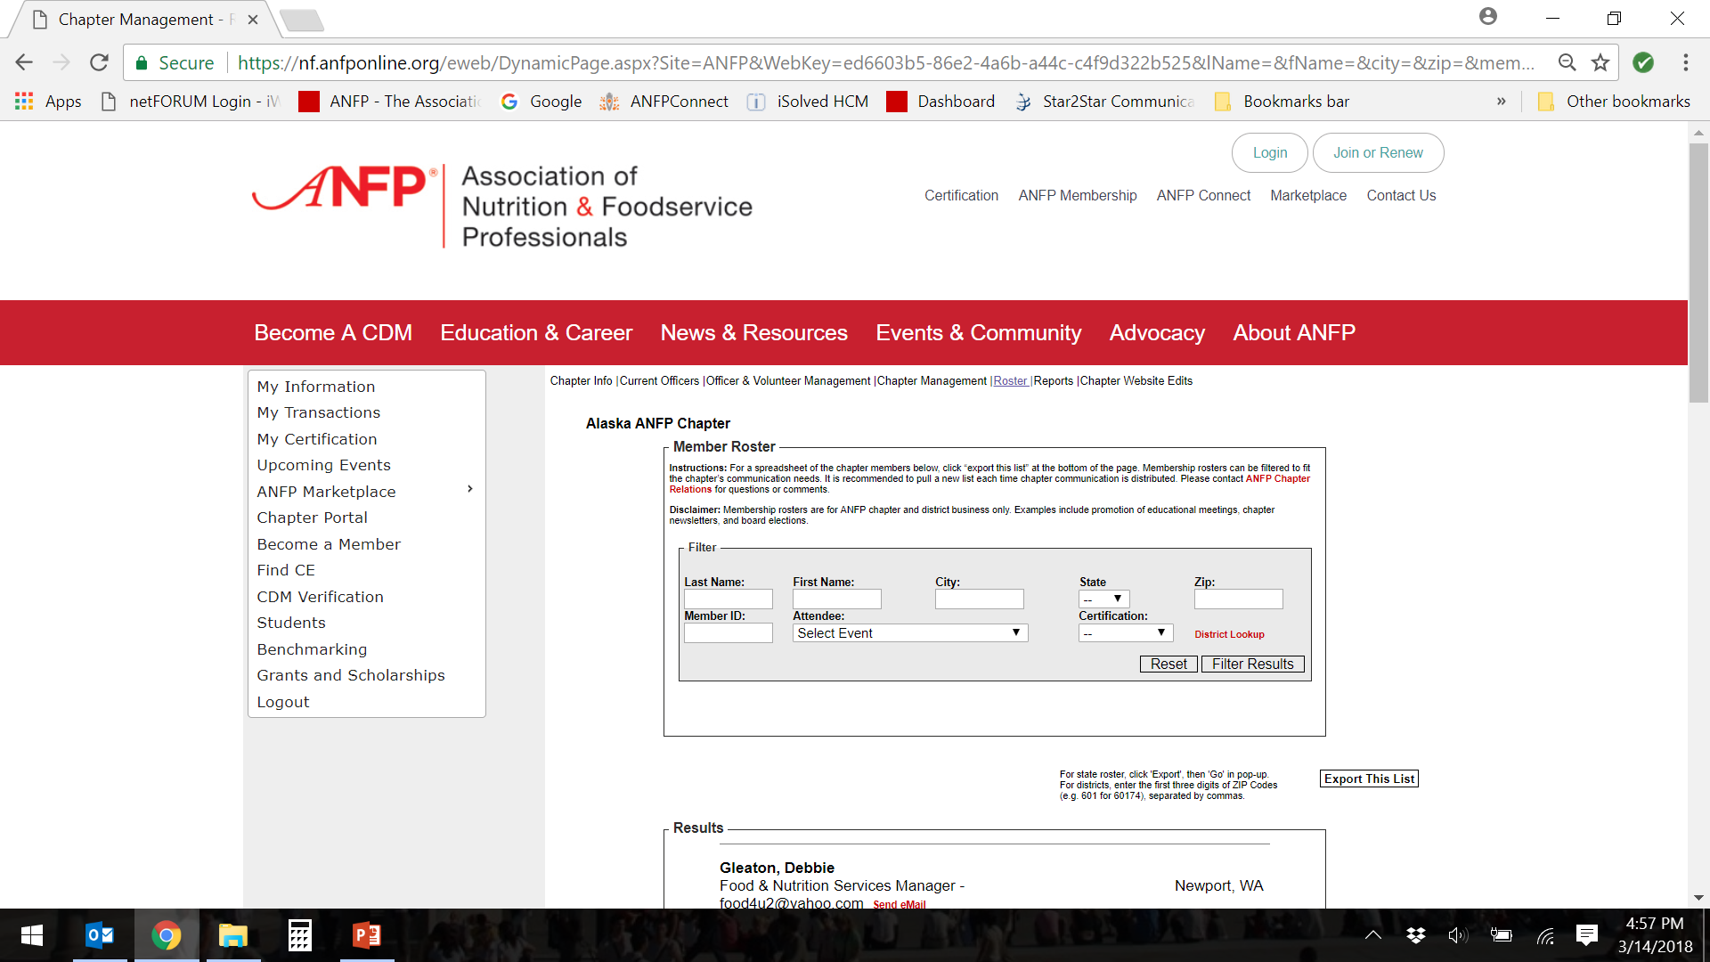
Chapter Portal
Notes:
Next, is the Roster tab. From here you are able to pull a full roster of your chapter’s membership. Scroll down to the bottom of the page an hit ‘export’.
Additionally, if you want to filter your results you could do so using a zip code, city or even certification. When using the roster for communication purposes or other chapter business, its recommend you pull a new list each time to ensure you have the most accurate member information.

Slide 26
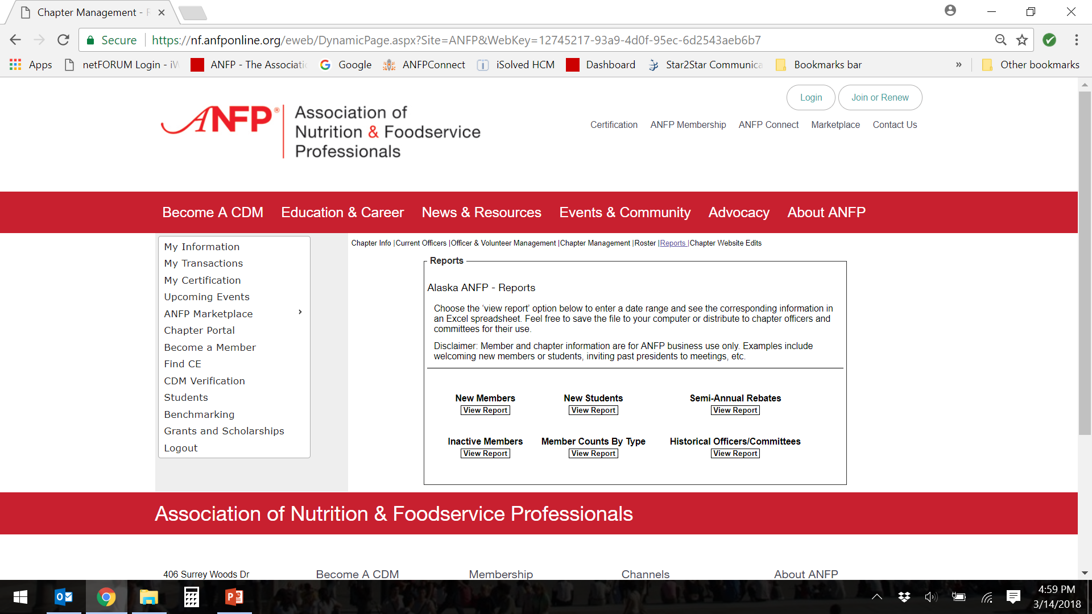
Chapter Portal
Notes:
The next tabs is used for pulling member reports members. As you see here, you can pull various reports including new members, new students or pre-professional, as well as inactive members.
Simply click on the ‘View Report’ button. You may be prompted for additional criteria like a date range.
The information will then download into an excel spreadsheet. Of course we ask that you use this information for official ANFP business only.

Slide 27
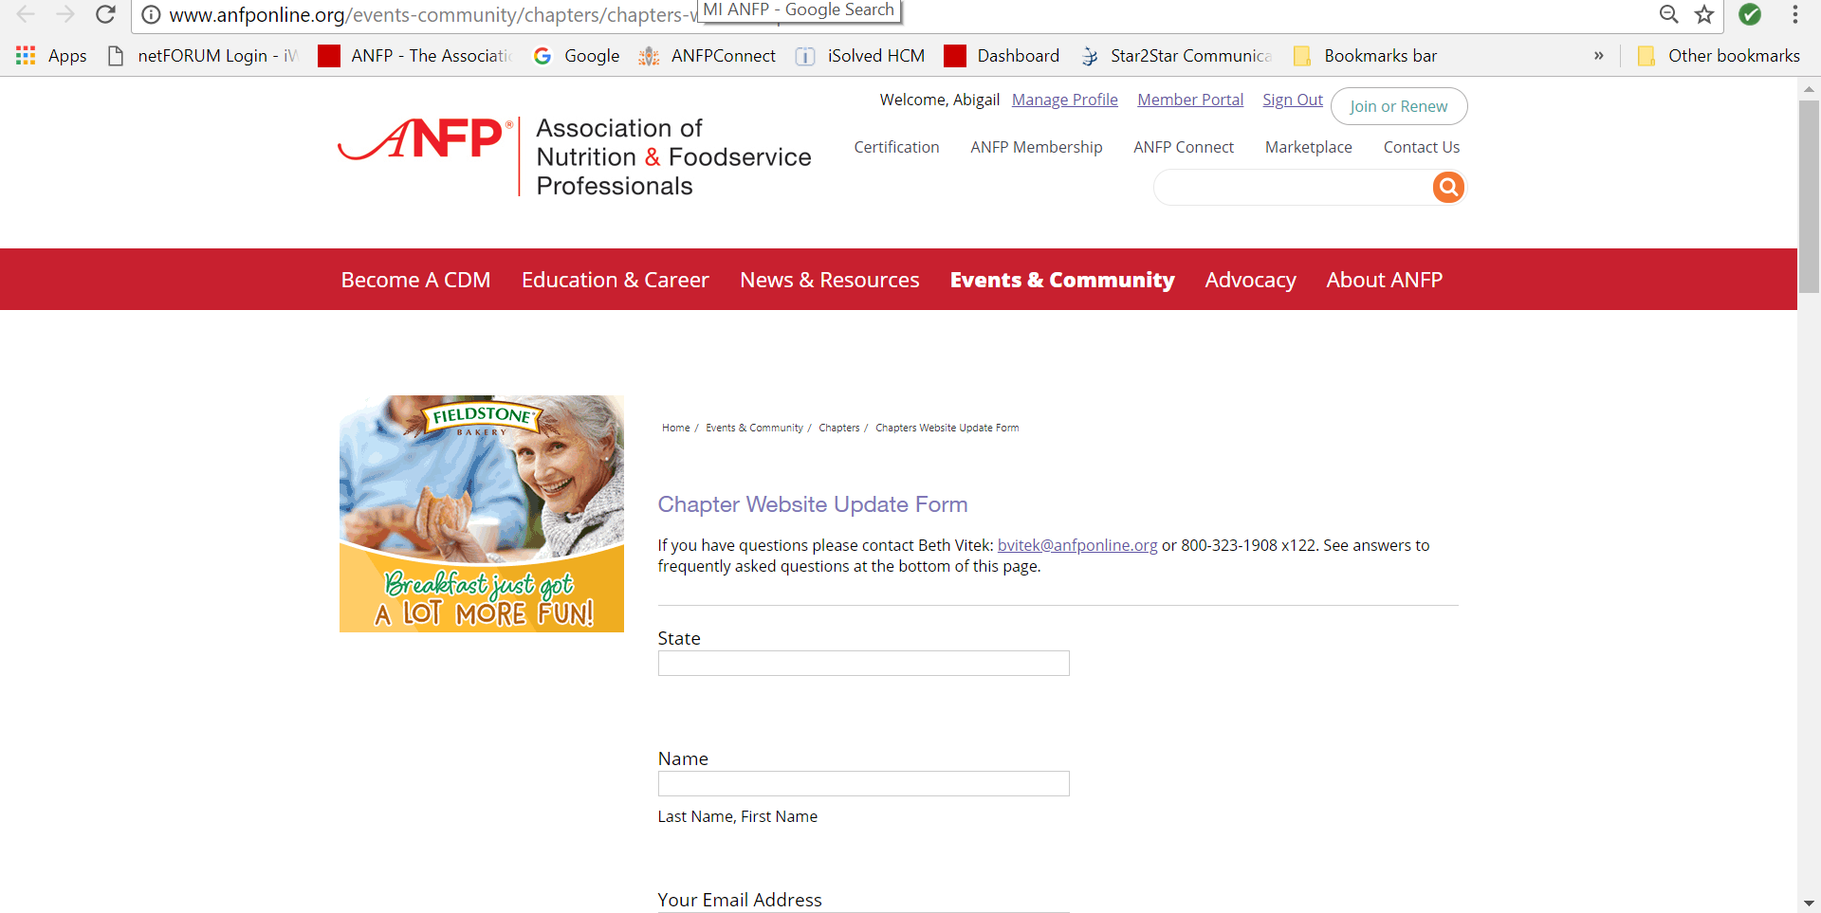
Chapter Portal
Notes:
And the last tab in the chapter portal is the chapter website update form. This is where you can submit any information you would like posted on your chapter website.
Meeting information, volunteer opportunities, chapter news etc. You’ll need to complete each of the fields and upload any files you would like posted and of course any additional instructions, and then hit submit.
This goes directly to the Chapters inbox here at the ANFP offices. Its monitored daily and typically your posts are completed within 24 to 48 hours if submitted during the week.
We encourage you to submit content for you website as often as you can as this helps keeps members informed and engaged.
Are there any questions at this time?

Slide 28
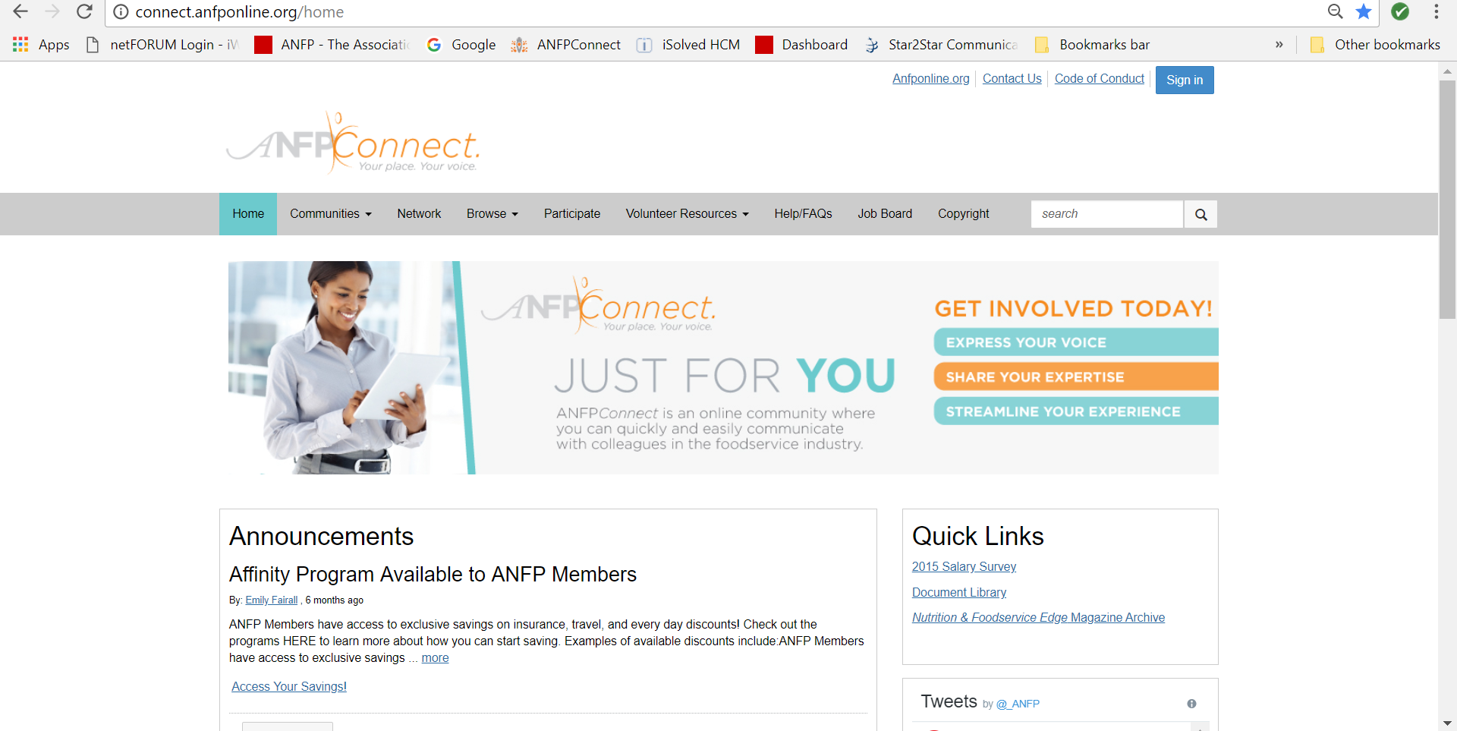
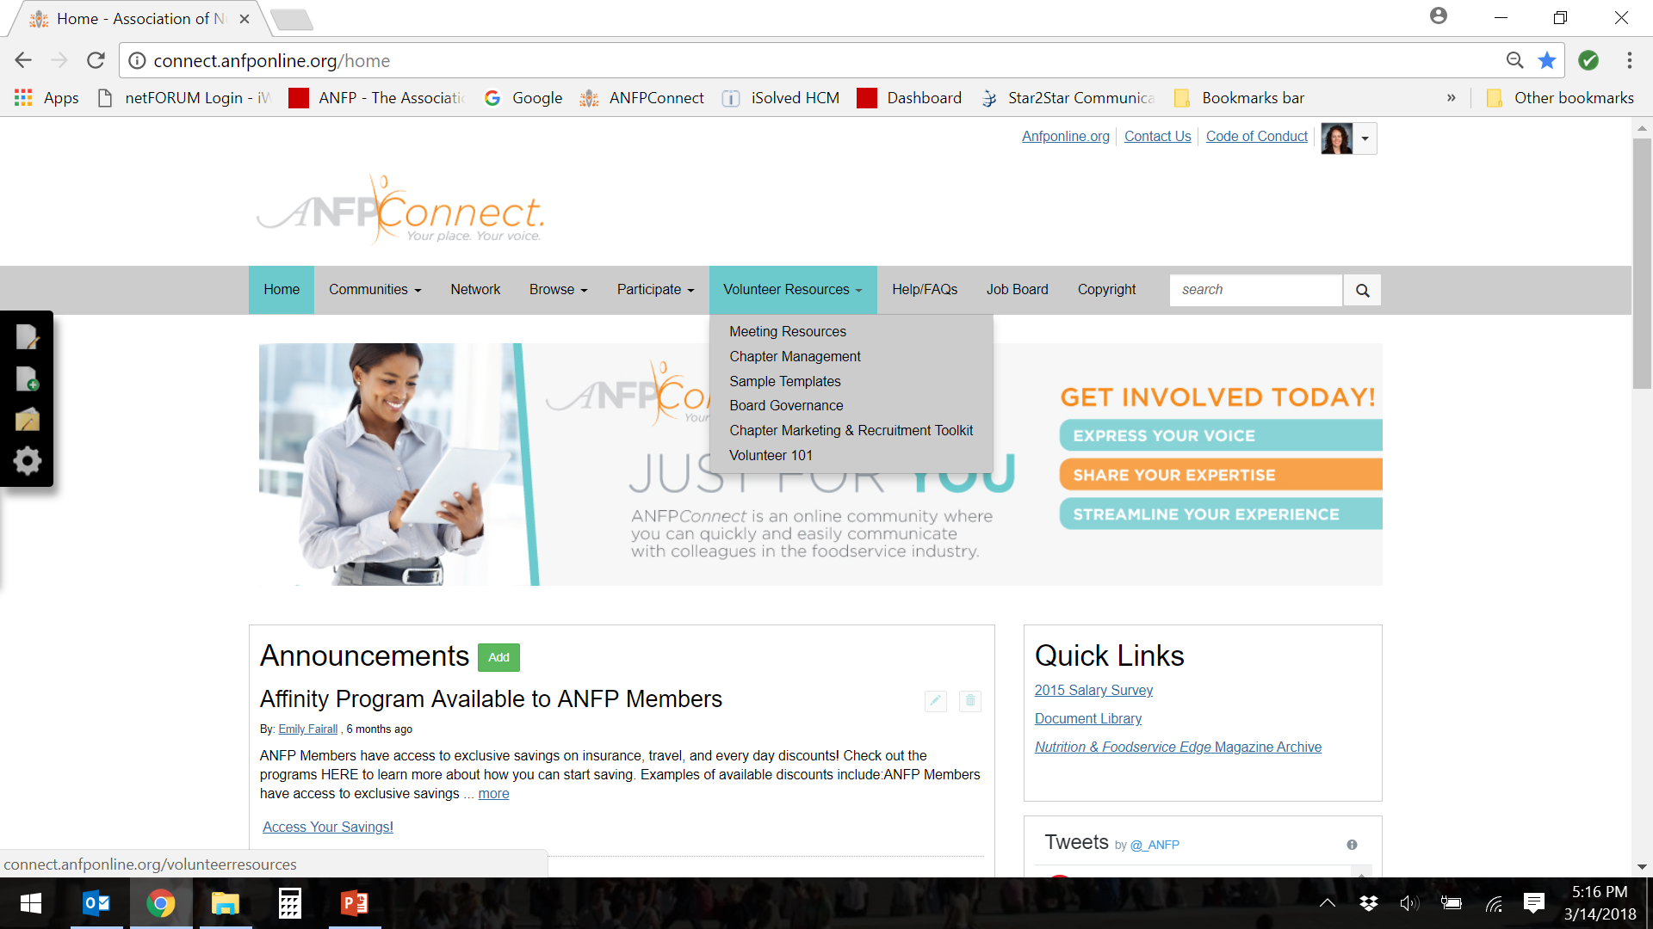
ANFPConnect
Notes:
You must be logged in to access documents.
As some of you may already be familiar with ANFP Connect, our member portal that contains a plethora of information and resources, not all of you may yet be familiar with Volunteer Resources which is a section dedicated to all information and tools for ANFP volunteers.

Slide 29
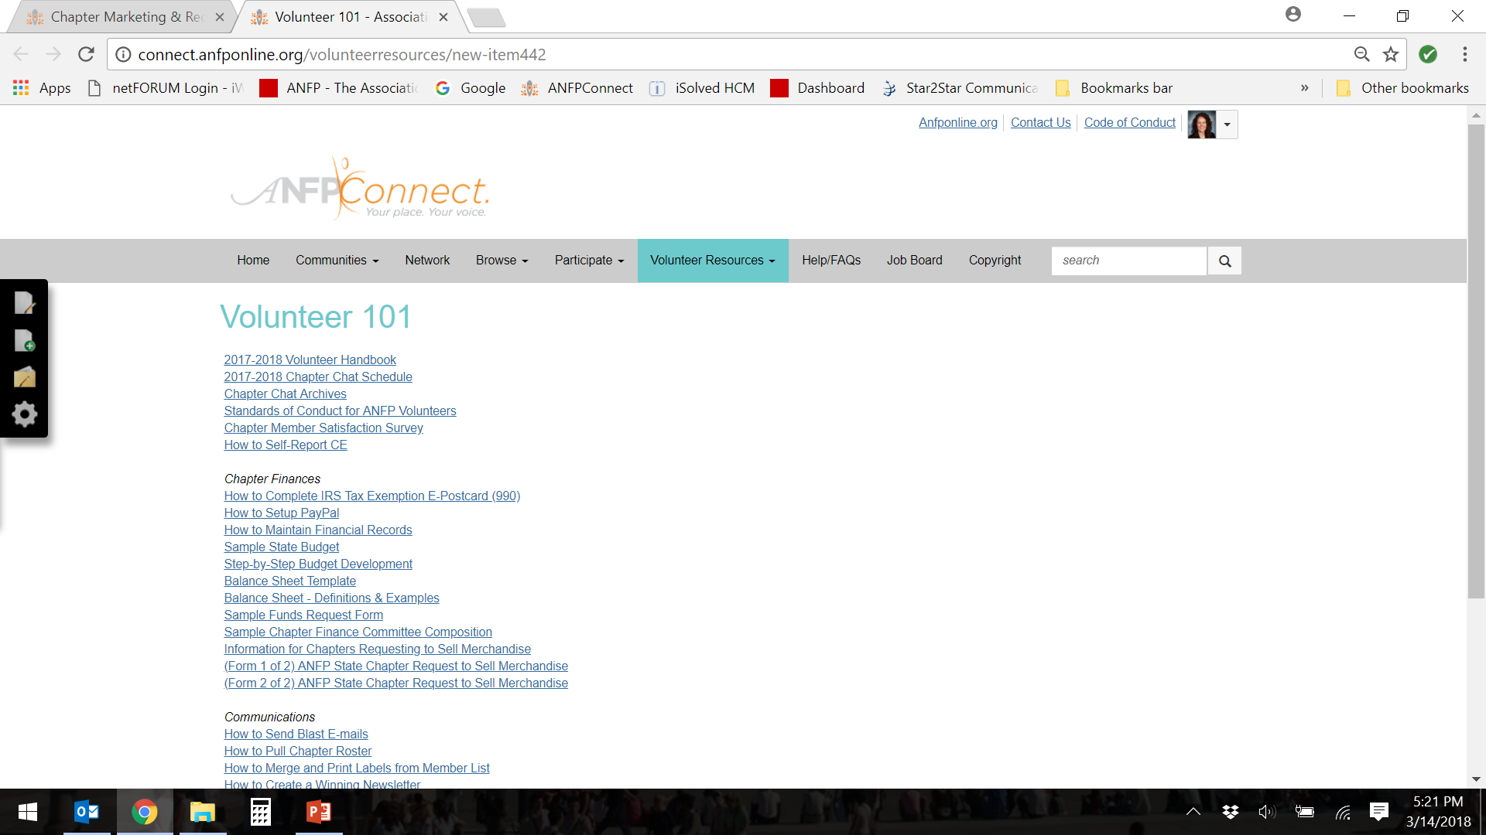
ANFPConnect
Notes:
Volunteer 101
So let’s walk through a brief tutorial of sorts of Volunteer Resources.
Once you are logged in on anfponline.org, go ahead and click on AFNP Connect on the top right hand side of the screen which will then take you to the screen you see here. Then go to the menu bar and select Volunteer Resources. Also, just a note, you may have to login again to access the resources and you would do so simply by clicking the sign in button at the top, right side of the page.
Ok, so the first section of Volunteer Resources is Volunteer 101.
Volunteer 101 includes many of the basic tools and resources needed for your time volunteering with ANFP. It includes documents like
2017-2018 Volunteer Handbook
2017-2018 Chapter Chat Schedule
Standards of Conduct for ANFP Volunteers
Chapter Member Satisfaction Survey
How to Self-Report CE
Chapter Finances
How to Complete IRS Tax Exemption E-Postcard (990)
How to Setup PayPal
How to Maintain Financial Records
Sample State Budget
Step-by-Step Budget Development
Balance Sheet Template
Balance Sheet - Definitions & Examples
Sample Funds Request Form
Sample Chapter Finance Committee Composition
Communications
How to Send Blast E-mails
How to Pull Chapter Roster
How to Merge and Print Labels from Member List
How to Create a Winning Newsletter
ANFP Style Guide
How to Recruit New Volunteers
And it also includes the ANFP Volunteer Handbook. This is a very handy tool for those that are new to volunteering as it gives you all the information you may need as a volunteer. It includes officer descriptions, chapter minimum standards, rebate requirements and deadlines as well as other useful information.

Slide 30
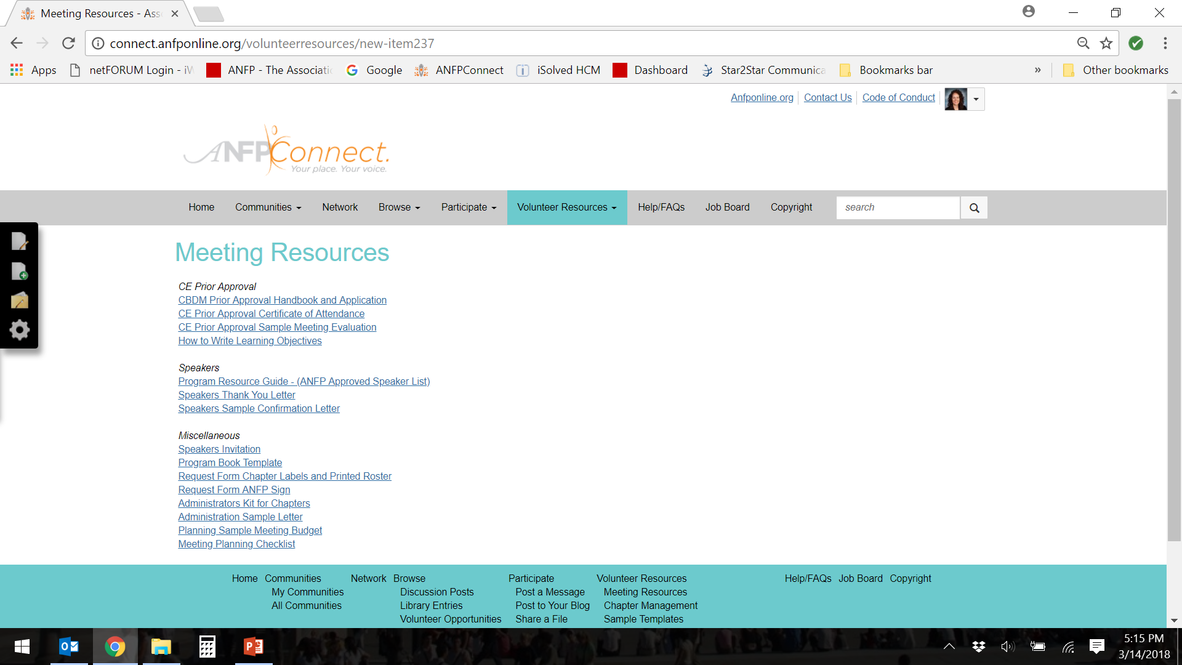
ANFPConnect
Notes:
Meeting Resources. Meeting resources contains templates and tools that you may need to run a successful chapter or educational meeting, including a CE prior approval form and supporting documents. Additionally, there are other documents to help with the planning of the meeting including a checklist, speaker invite template speaker directory as well as the request form for those that would like to use the ANFP pull up banner which is complimentary to chapters.
CE Prior Approval
CBDM Prior Approval Form
CE Prior Approval Certificate of Attendance
CBDM Prior Approval Handbook
CE Prior Approval Sample Meeting Evaluation
Speakers
Program Resource Guide (Speaker Directory)
Speakers Thank You Letter
Speakers Sample Confirmation Letter
Miscellaneous
Speakers Invitation
Program Book Template
Request Form Chapter Labels and Printed Roster
Request Form ANFP Sign
Administrators Kit for Chapters
Administration Sample Letter
Planning Sample Meeting Budget
Planning Meeting Checklist

Slide 31
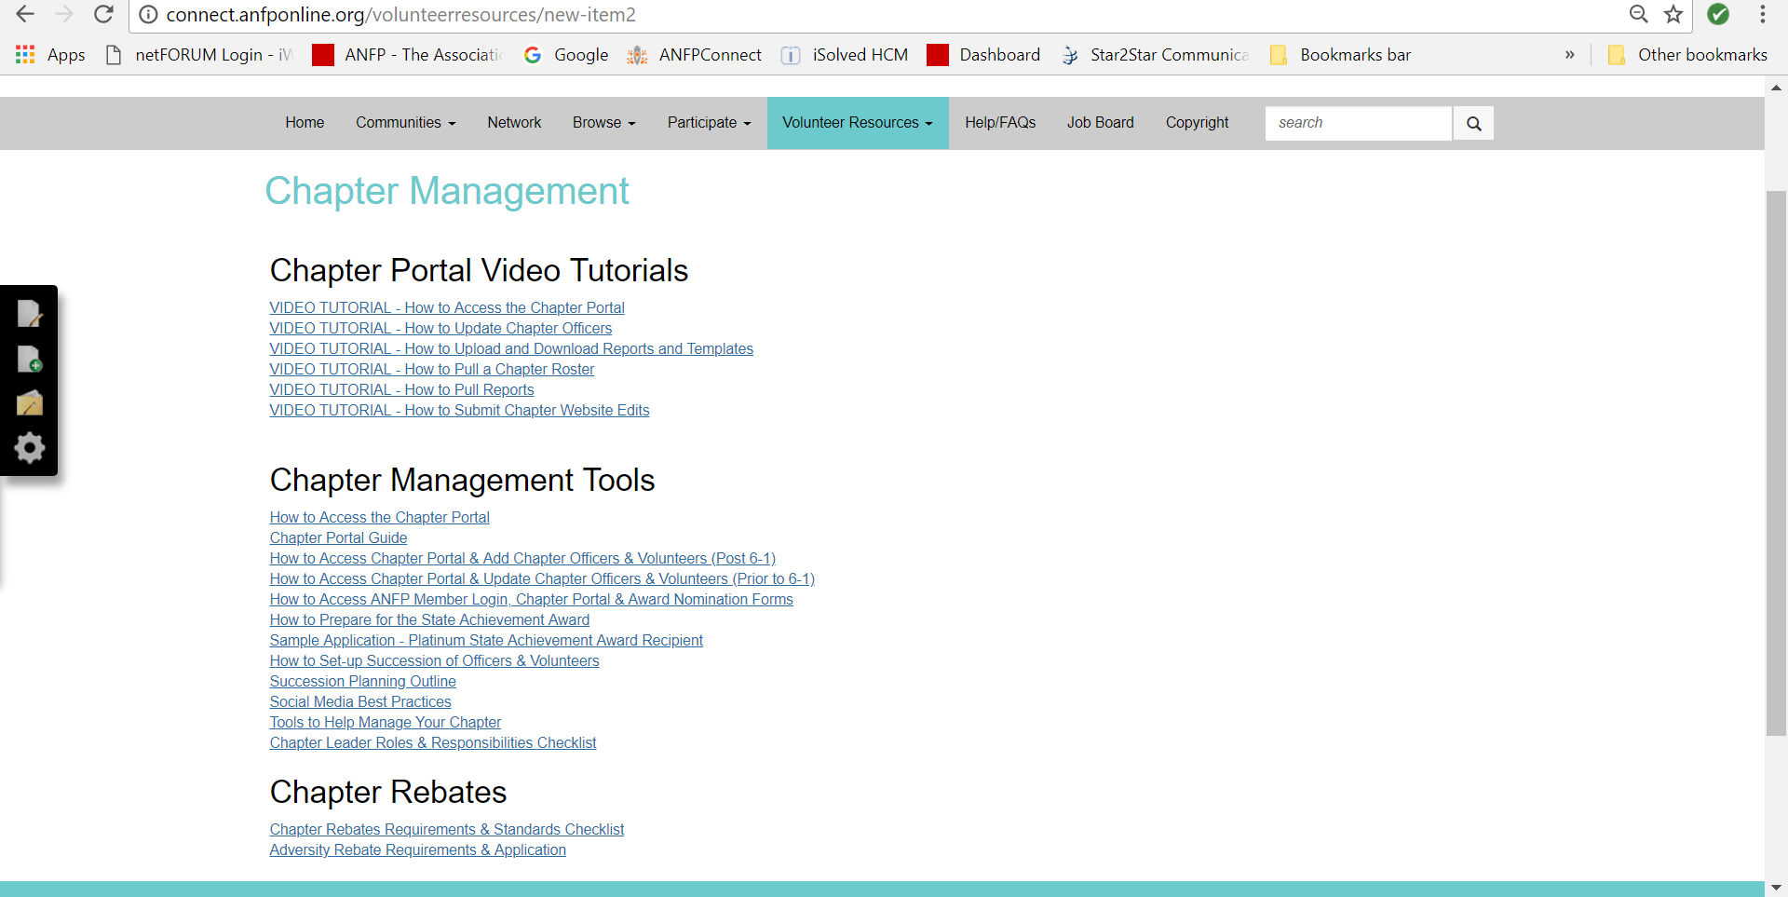
ANFPConnect
Notes:
Chapter Management
Next, chapter management includes documents strictly related to business and management of chapters. I specifically want to point out the chapter portal guide. This is an overview of each of the links in the portal we just discussed. It’s a great, quick reference for those of us that are not in the portal that often and can’t always remember where certain reports or documents are stored. Additionally, there are step-by-step instructions on how to access the portal as well as video tutorials for how to’s in the chapter portal.
There are also many other documents to help you with chapter management during your term, including ‘tools to help manage your chapter’ that list online tools for surveying, conference calls, virtual meetings and other resources.
This is also where you can find the checklist for rebate requirements as well as.
How to Access the Chapter Portal
Chapter Portal Guide
How to Access Chapter Portal & Add Chapter Officers & Volunteers (Post 6-1)
How to Access Chapter Portal & Update Chapter Officers & Volunteers (Prior to 6-1)
How to Access ANFP Member Login, Chapter Portal & Award Nomination Forms
How to Prepare for the State Achievement Award
Sample Application - Platinum State Achievement Award Recipient
How to Set-up Succession of Officers & Volunteers
Succession Planning Outline
Social Media Best Practices
Tools to Help Manage Your Chapter
Chapter Leader Roles & Responsibilities Checklist
Chapter Rebates
Chapter Rebates Requirements & Standards Checklist
Adversity Rebate Requirements & Application

Slide 32
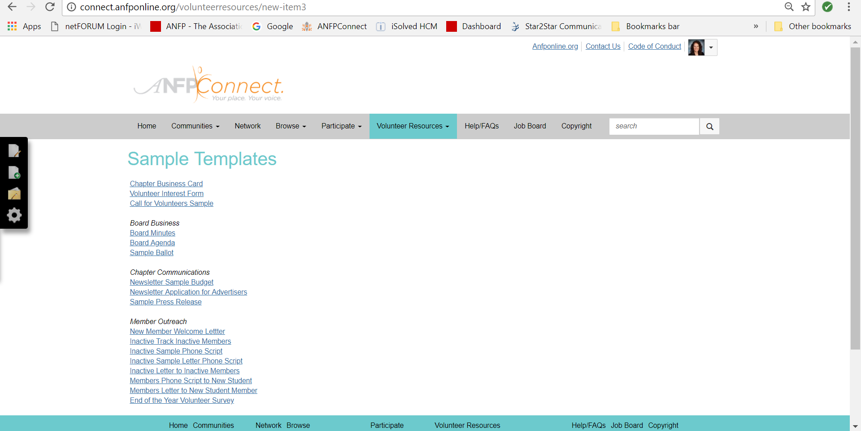
ANFPConnect
Notes:
Next are the sample templates. There are various templates that you may find useful as a volunteer, including board minutes and agenda template, invite letter to new students or volunteer interest form. Again, these are only samples. Chapter Business Card
Volunteer Interest Form
Board Business
Board Minutes
Board Agenda
Sample Ballot
Chapter Communications
Newsletter Sample Budget
Newsletter Application for Advertisers
Sample Press Release
Member Outreach
Inactive Track Inactive Members
Inactive Sample Phone Script
Inactive Sample Letter Phone Script
Inactive Letter to Inactive Members
Members Phone Script to New Student
Members Letter to New Student Member
Members Letter to New Student

Slide 33
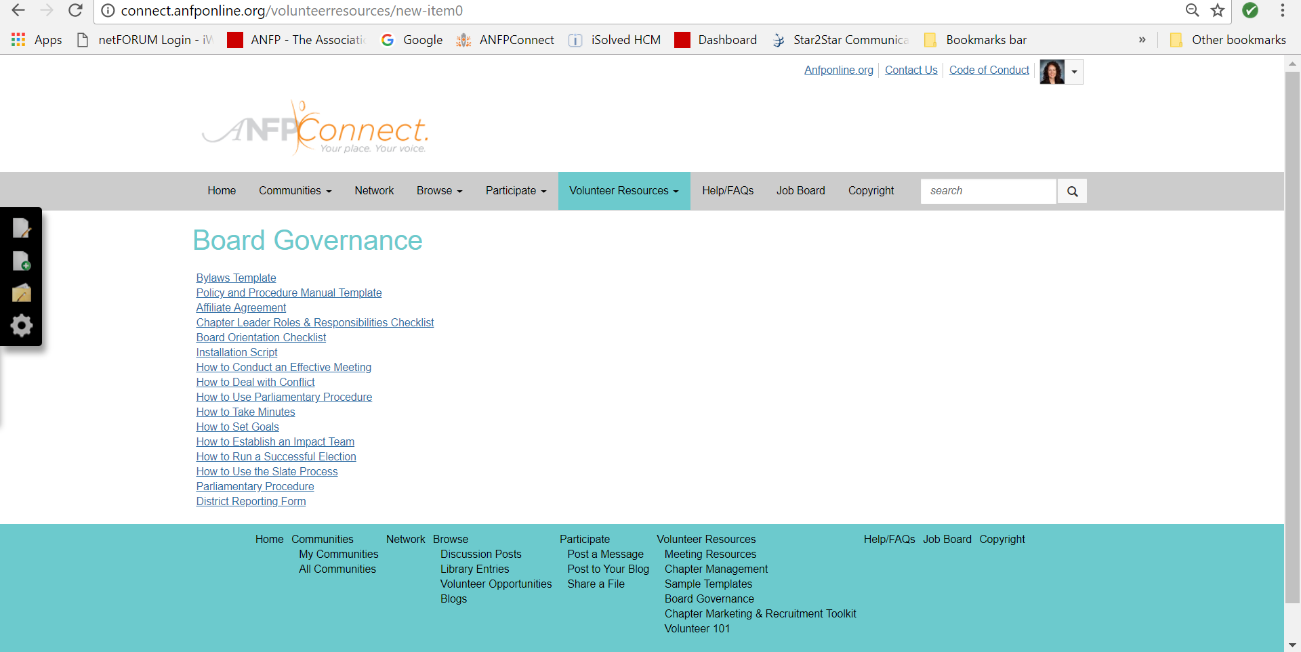
ANFPConnect
Notes:
Next, board governance. Board governance are more resources and tools for those that are serving as officers. Familiarize yourself with some of these documents like the affiliate agreement, parliamentary procedure or state budget template. As you’ll see there are other great resources here for governance purposes as well.
Bylaws Template
Policy and Procedure Manual Template
Affiliate Agreement
Chapter Leader Roles & Responsibilities Checklist
Board Orientation Checklist
Installation Script
How to Conduct an Effective Meeting
How to Deal with Conflict
How to Use Parliamentary Procedure
How to Take Minutes
How to Set Goals
How to Establish an Impact Team
How to Run a Successful Election
How to Use the Slate Process
Parliamentary Procedure

Slide 34
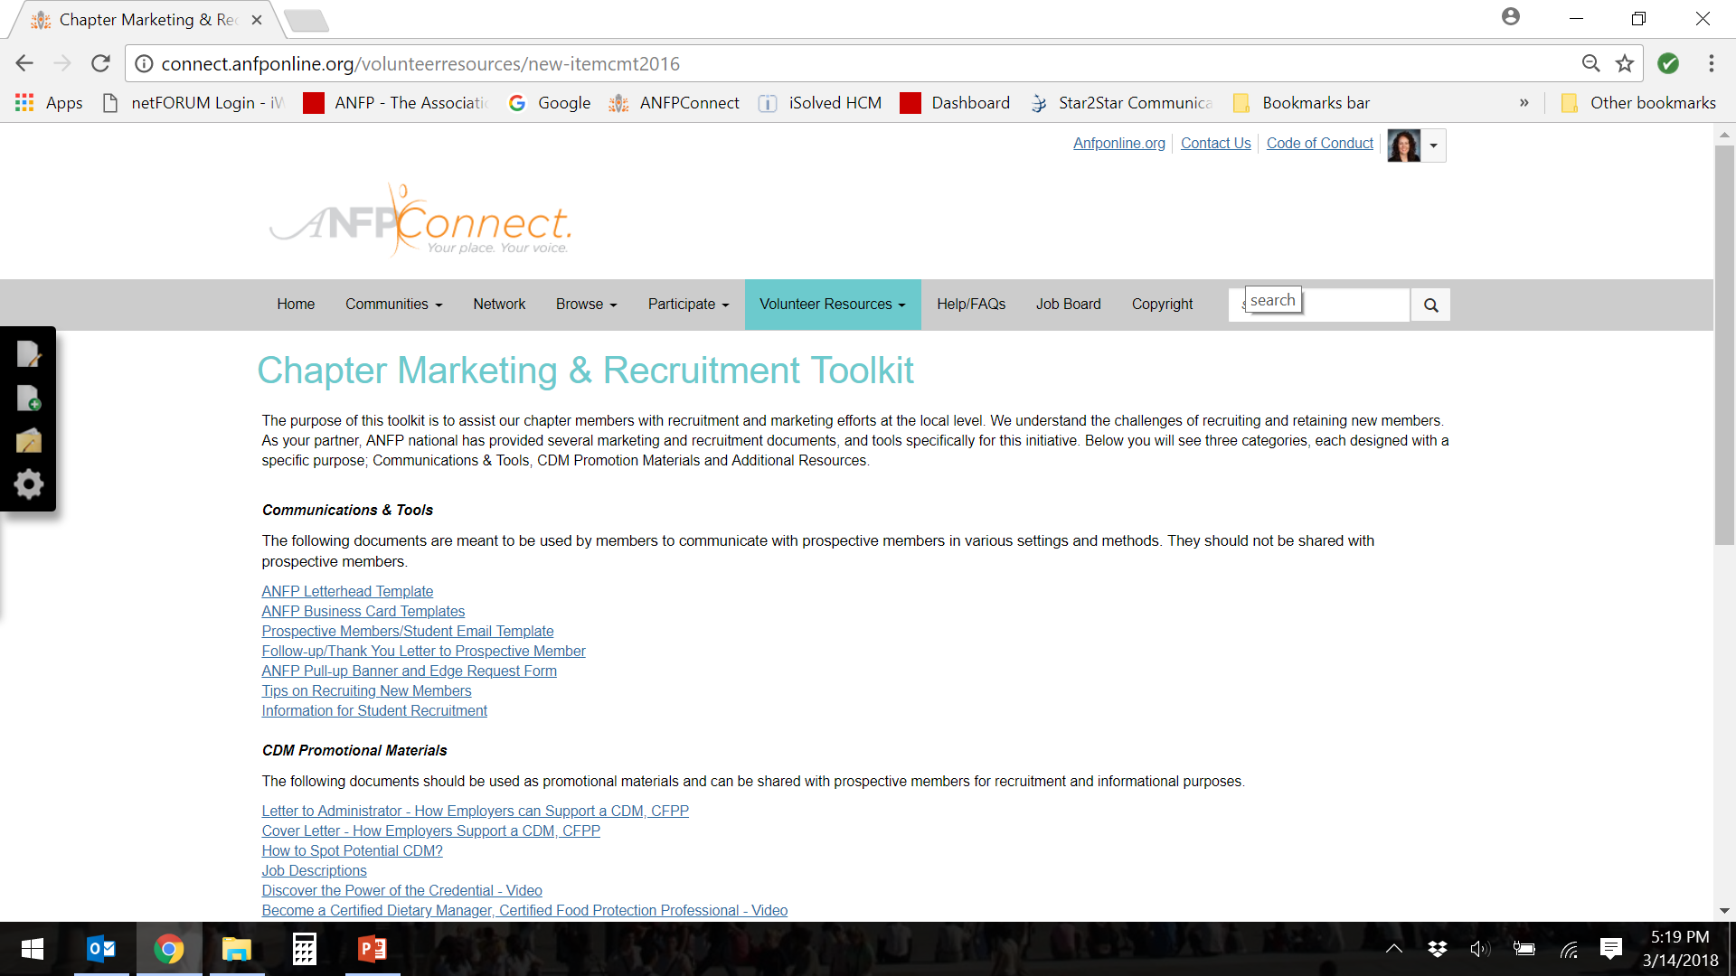
ANFPConnect
Notes:
Chapter Marketing and recruitment toolkit. The purpose of this toolkit is to assist our chapter members with recruitment and marketing efforts at the local level. We understand the challenges of recruiting and retaining new members. As our partner, ANFP national has provided several marketing and recruitment documents, and tools specifically for this initiative. Below you will see three categories, each designed with a specific purpose; Communications & Tools, CDM Promotion Materials and Additional Resources.
Ok, so I know that was a lot that I threw out there, but know you can access Volunteer Resources at any time. So, take some time to look around and become familiar with the tools and documents that we have available for you. Also, if you don’t find something you are looking for, please reach out to other chapter officers or national to inquire.

Slide 35
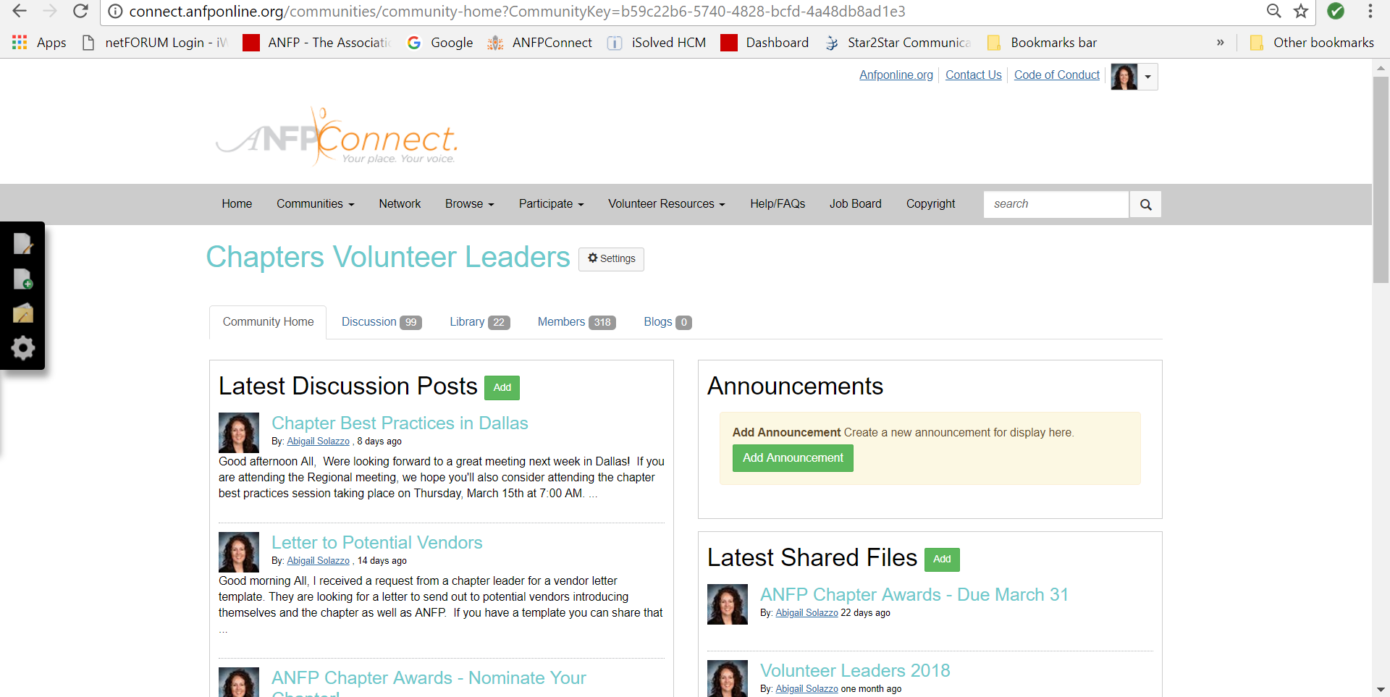
Chapter Volunteer Leaders Forum
Notes:
I don’t want you to feel overwhelmed. You don’t have to memorize and understand it all today. It will take time and patience to learn your new role, but please know that you have many other chapter leaders not only within your own chapter, but throughout the country you can reach out to.
And you can do so by using our chapter leaders volunteer forum, which is available here on ANFPConnect
This forum works just like Open Forum. You simply post a question, and other chapter leaders will respond.
You may also contact chapter leaders directly by looking them up in the member directory
Ok, any other questions at this time?

Slide 36
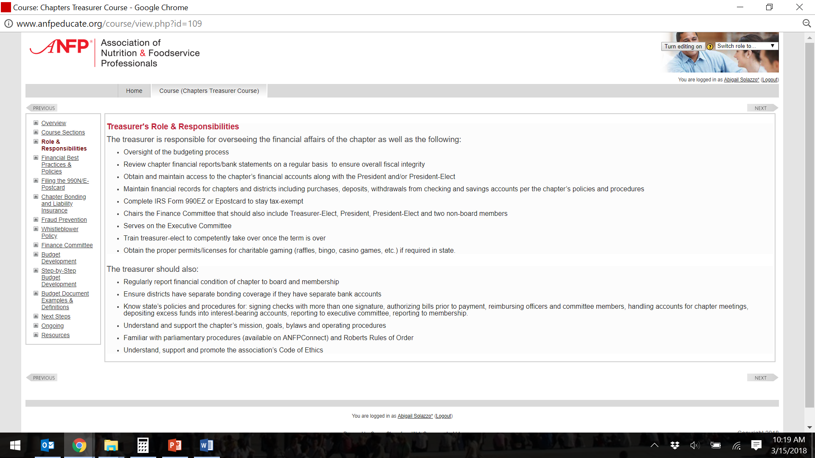
LMS Online Courses
Notes:
Additionally, there are online courses for the roles of the President, Treasurer, Secretary, and Newsletter Editor. Each course covers specific role responsibilities in detail. These courses are complimentary for chapter leaders with a code provided by National. However, we are asked to only allow two chapter leaders to take each course per year.
These courses can be found in the Marketplace on the ANFP website.

Slide 37
Mentor Guidelines
Listen and respect the opportunities and suggestions
Use active listening skills during discussions
Prepare the goals and objectives
Take the initiative to ask for feedback
Always be considerate and respect your mentor’s time as you do your own.
Return phone calls promptly and be on time with commitments or meetings
Seriously consider all advice or suggestions you receive.
Notes:
And last, we wanted to briefly go over a few mentorship guidelines. As you all know, the our outgoing chapters leaders have graciously agreed to be available as mentors or act as a during your first year as a new board. So we encourage you all to reach out to them for advice and guidance. However, we would ask that you please keep a few things in mind when it comes your mentee/mentor relationship. I think as professionals who have likely been mentored or mentored others, these guidelines will be familiar.
Listen and respect the opportunities and suggestions – even if you don’t take their suggestion, and wish to decline, do so in a respectful manner
Use active listening skills during discussions – listen carefully to all they have to say
Prepare the goals and objectives - prior to reaching out to your mentor, prepare your goals or at least questions or items for discussion.
Take the initiative to ask for feedback – The chapter leaders are there to help, but without asking, they’ll never know what you need
Seriously consider all advice or suggestions you receive. – And once you receive and answers or feedback, take time to reflect on what they have said.
Always be considerate and respect your mentor’s time as you do your own. – As this is another volunteer role they’ve agreed to take on, we ask that you are respectful of their time and understand if you do not get an immediate response
Return phone calls promptly and be on time with commitments or meetings – again, being respectful of each other’s time is something we are all familiar with.
Any questions about this?

Slide 38
Additional Resources
ANFPConnect – Volunteer 101
LMS Online Courses
Chapter Chats
Volunteer Leader & Handbook
Chapter Best Practices
Chapter Leadership Team
Other Chapter Leaders
ANFP Staff
Notes:
Last, there are additional resources available for you including
Chapter Leadership Team – Committee of national representatives here to help provide guidance and support to all chapter leaders
Chapter Chats – Webinars that cover an array of topics to volunteer recruitment to teambuilding. The full scheduled is available on ANFP Connect in Volunteer 101.
Volunteer Leader – A monthly electronic newsletter covering relevant chapter management topics and ANFP updates.
Chapter Best Practices – Live, face-to-face sessions that convene chapter leaders to discuss best practices, and learn techniques and strategies related to chapter management.
Other Chapter Leaders – There are over 300 chapter leaders in ANFP and are available to you via the chapter volunteer leaders forum.
ANFP Staff – ANFP has full-time staff dedicated for chapter support. Abigail Solazzo is reachable at asolazzo@ANFPonline.org or via phone at 630-587-6336.
And we encourage you to use all of these resources to ensure you succeed in your role.

Slide 39
Next Steps
  Determine conference call/meeting schedule
Survey members
Recruit, engage and retain!
Notes:
Now, our next steps as a board, we need to
- Set-up your regularly scheduled board meetings
- Consider a member satisfaction survey
- Ongoing and open communication between you and your chapter members
Recruit, engage and retain! – These efforts should take place year-round. Always be on the lookout for your successor and present volunteer opportunities for members whenever you can no matter how big or small the task is.

